Slide 1
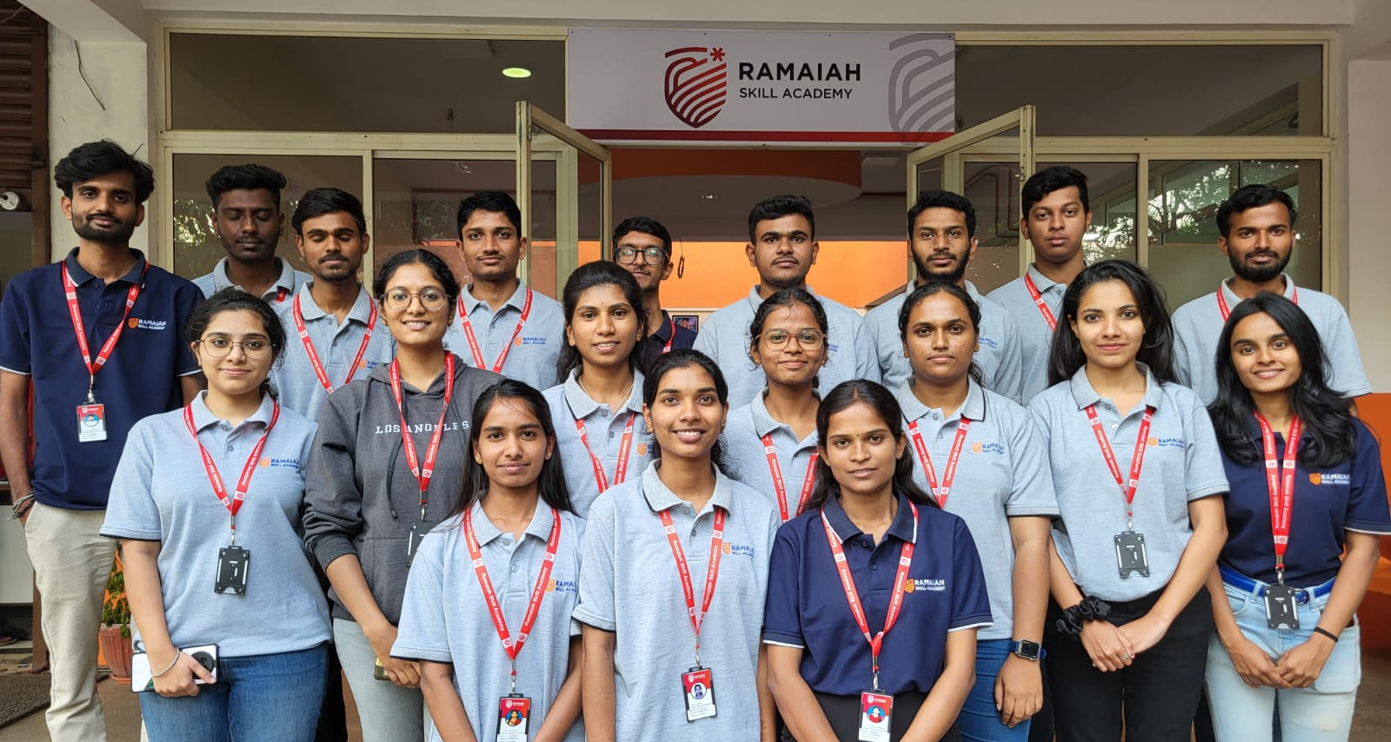
EMBEDDED SYSTEM DESIGN (ESD) Good Will Program - 2024

Slide 2

Topics
Digital Design
Introduction to Embedded Systems
Embedded Hardware and Architecture
Communication Protocols
Sensors and Actuators
Embedded Programming
Hands-on
Project

Slide 3
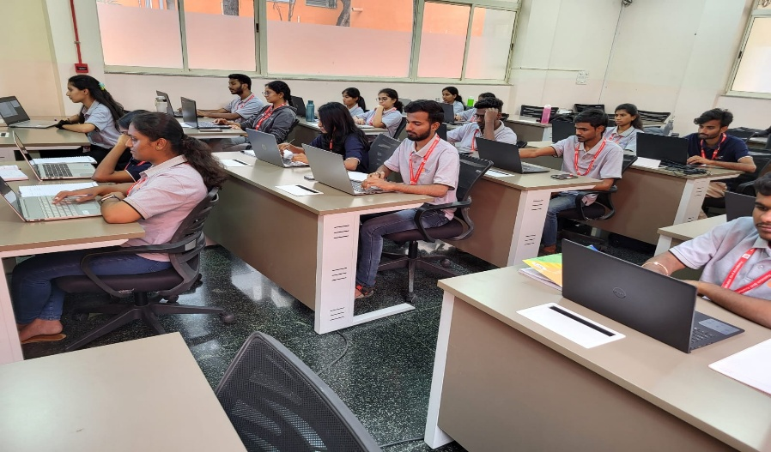
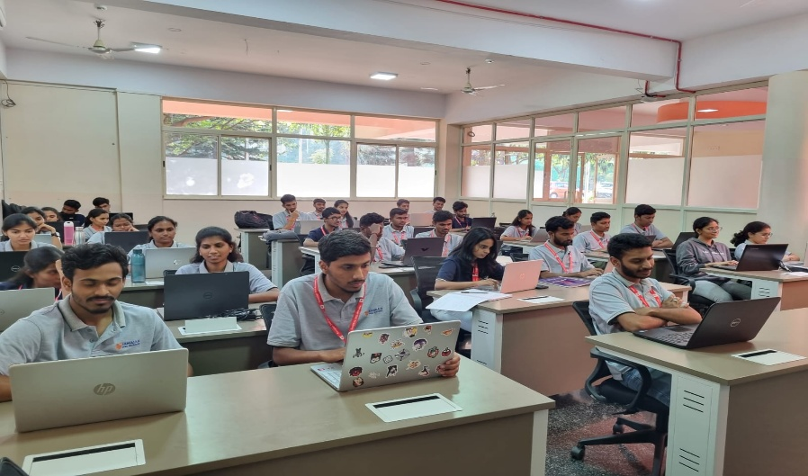
Peer Skill Learning
Provides Quality Expertise
Bridge Skill Gaps
Enhances Practical Performance
Drives Career Advancement
Empower Growth
Improve Team Collaboration

Slide 4
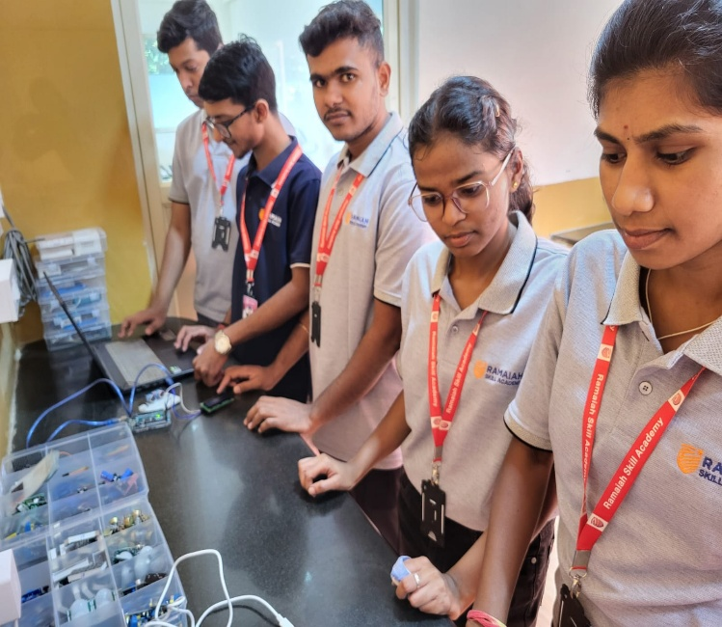
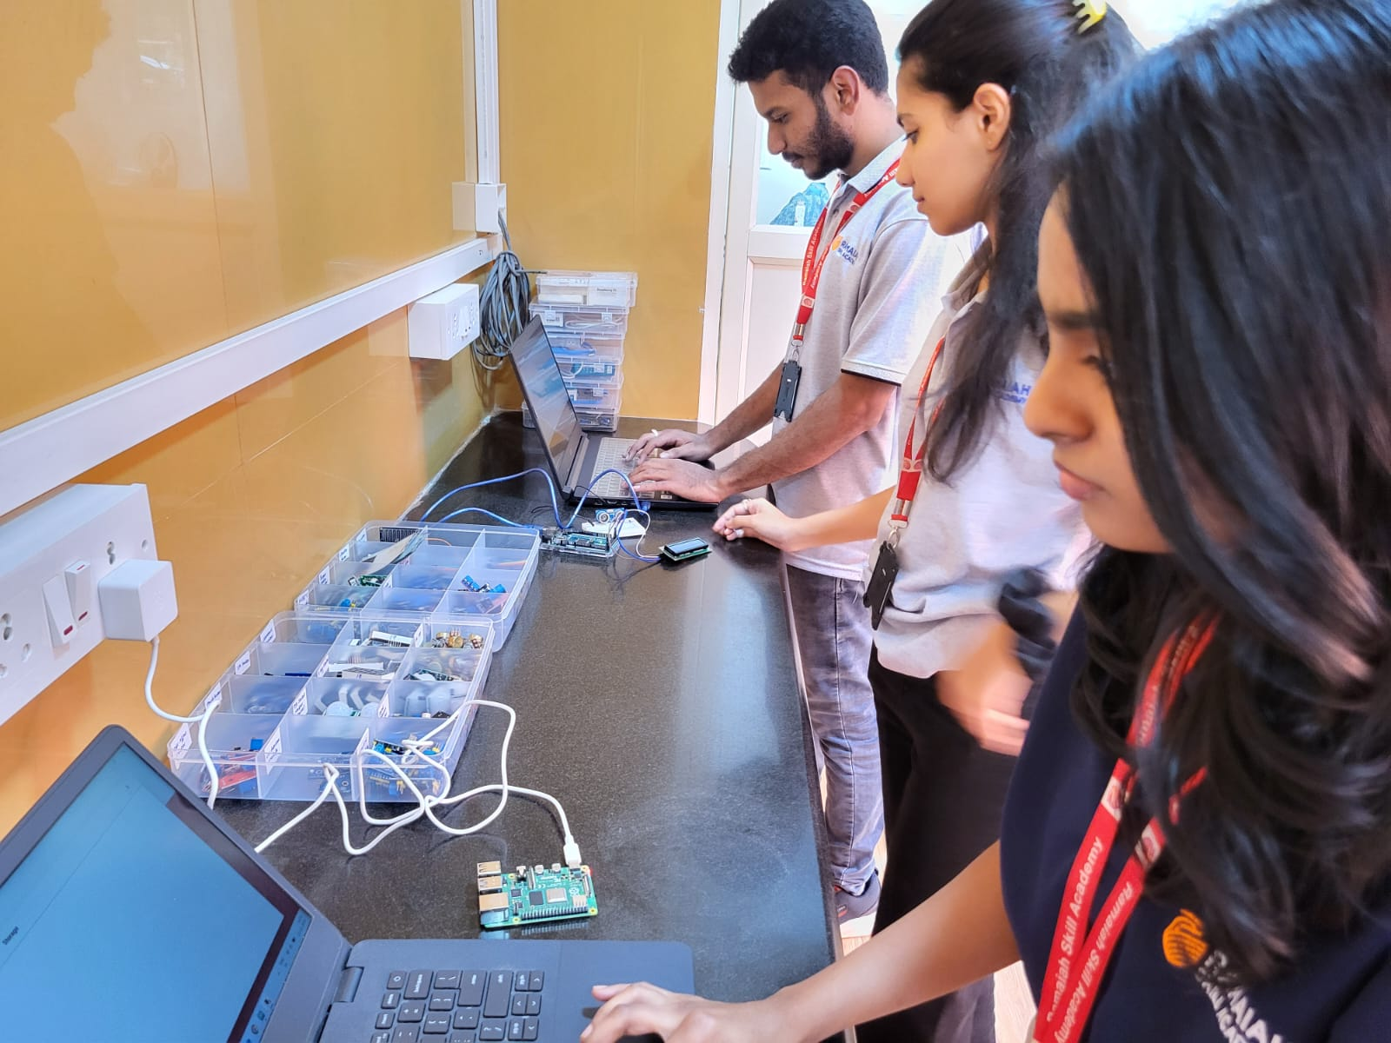
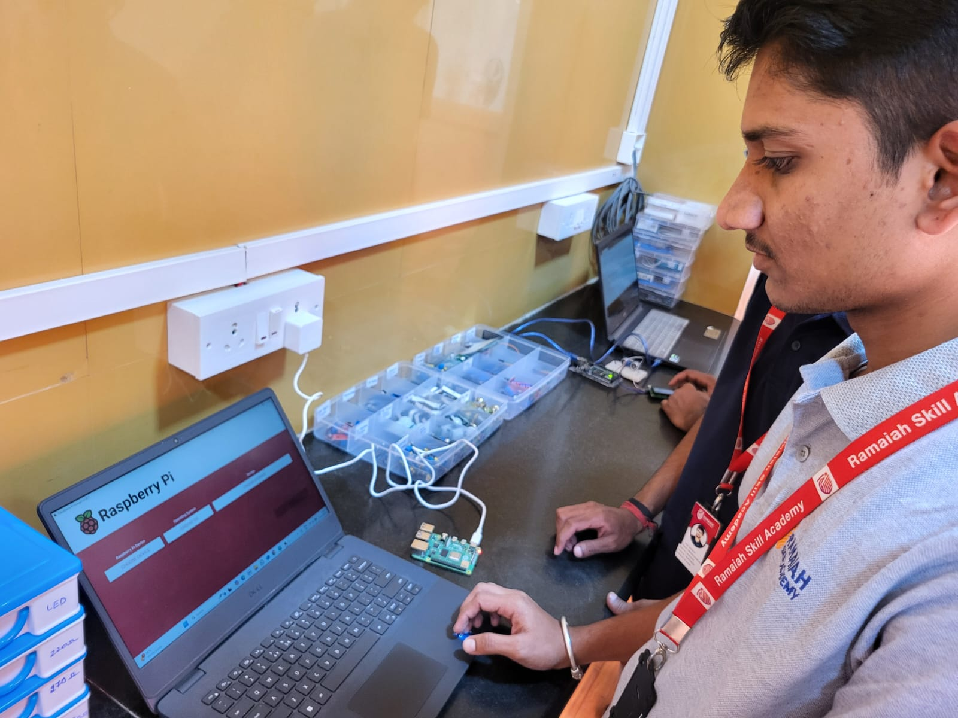
Collaborative & Hands-on Learning
Ramaiah Skill Academy (RSA) focuses on collaborative, Group activities and innovative thinking.
Apply skills in practical scenarios.

Slide 5
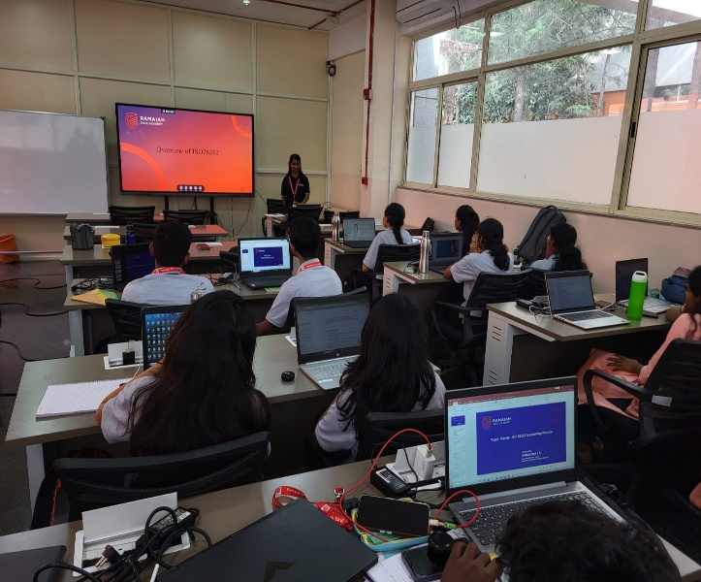
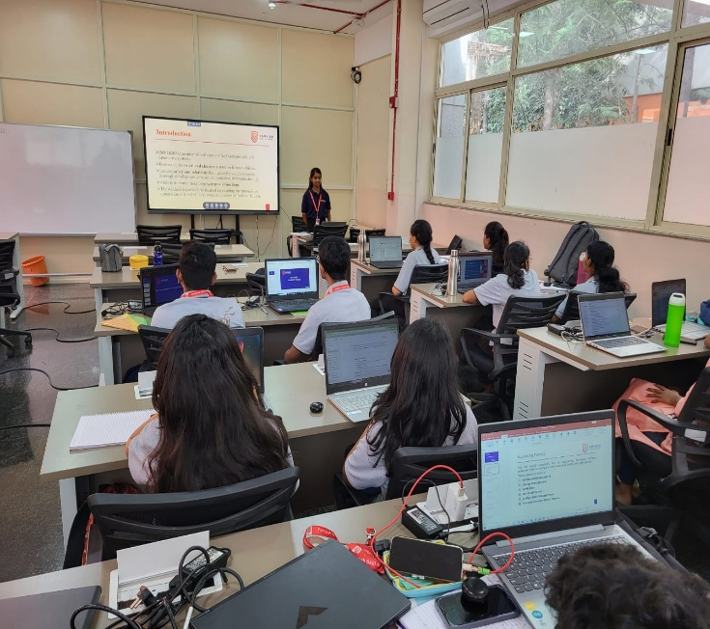
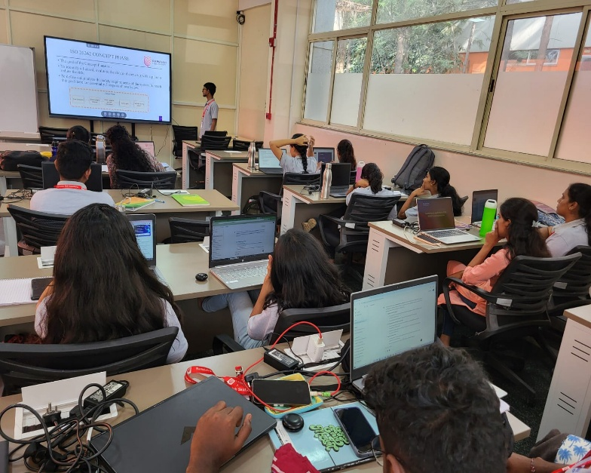
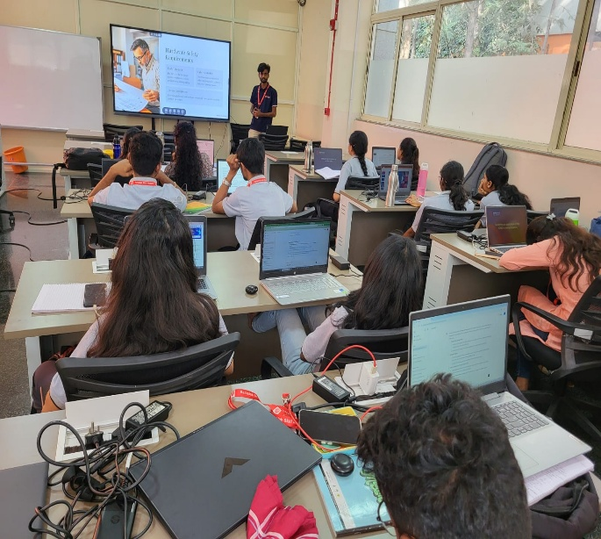
Trainee-led talk
Presenting a specific topic,
project, or idea.

Slide 6
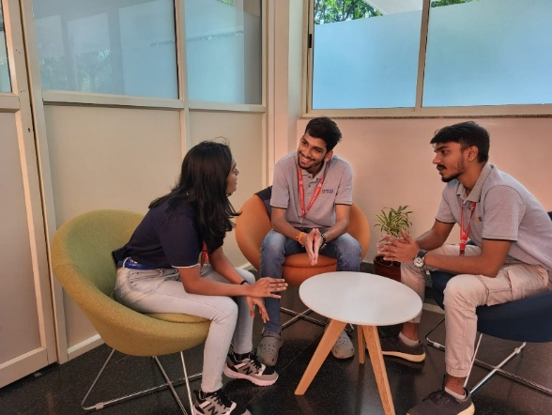
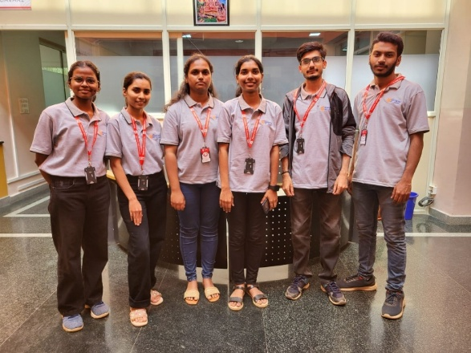
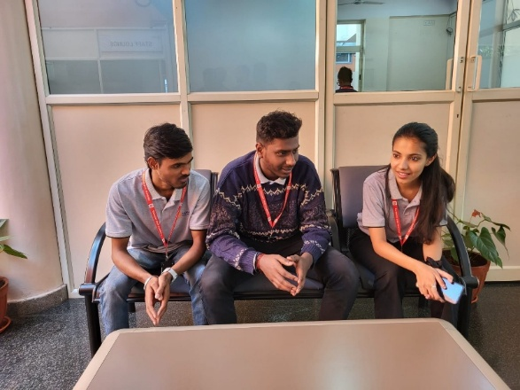
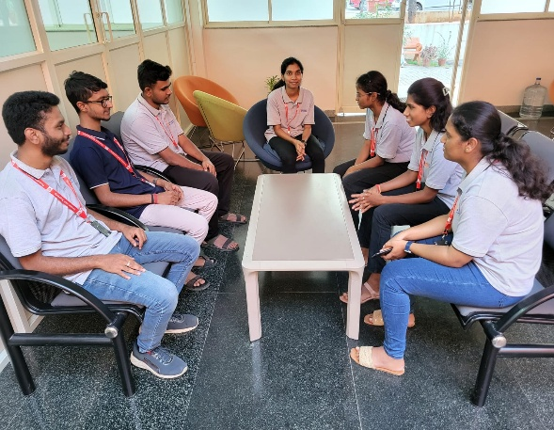
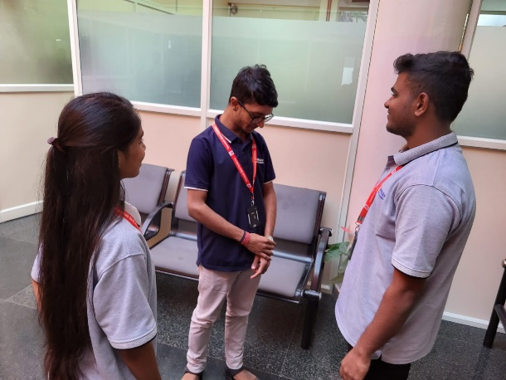
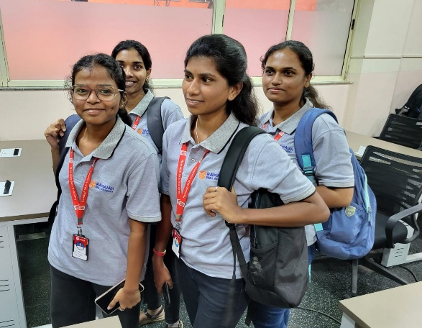
Beyond training hours
Learning extends beyond formal training hours, fostering continuous growth and development.

Slide 7
Thank You

